Slide 1


Slide 2
First Step is look at the big picture
The goal is to give you the specifications of the diamond and you give me the average price of the diamond
Supervised
Regression(continuous data (price))
Batch(He learns on existing data and does not learn on new data)offline)

Slide 3
Solution steps:
Read data
# Take a Quick Look at the Data Structure by use info ,describe,head and value_counts we use it with cut column to Explain each category or label and how many values ​​are present in it
. Discover and Visualize the Data to Gain Insights, Visualizing Geographical Data , Using a regression line to represent the relationship between price and weight, i.e. is there a relationship between price and weight?

Slide 4
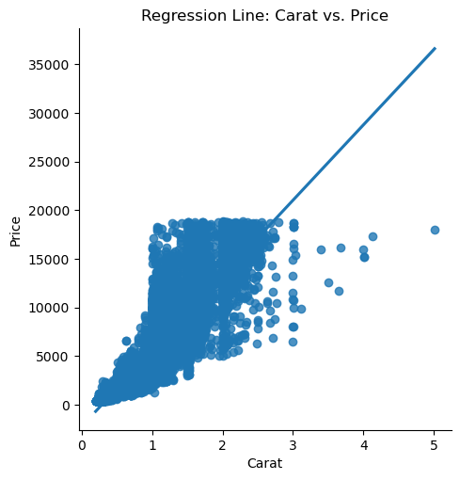
Discover and Visualize the Data
An ascending line indicates an upward/direct relationship. This indicates that diamonds with higher weights are usually more

Slide 5
Discover and Visualize the Data
# How does the price change with changes in color? Are there colors that have a higher value?
# There is a variation in the distribution of
# colors based on their price, as you noticed from the figure that some colors enjoy a higher price compared to others.
#Color I and J has price more than others

Slide 6
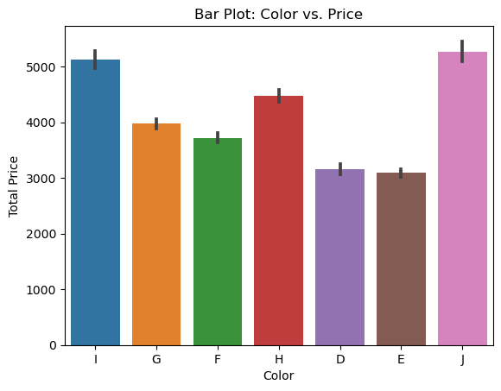
Discover and Visualize the Data

Slide 7
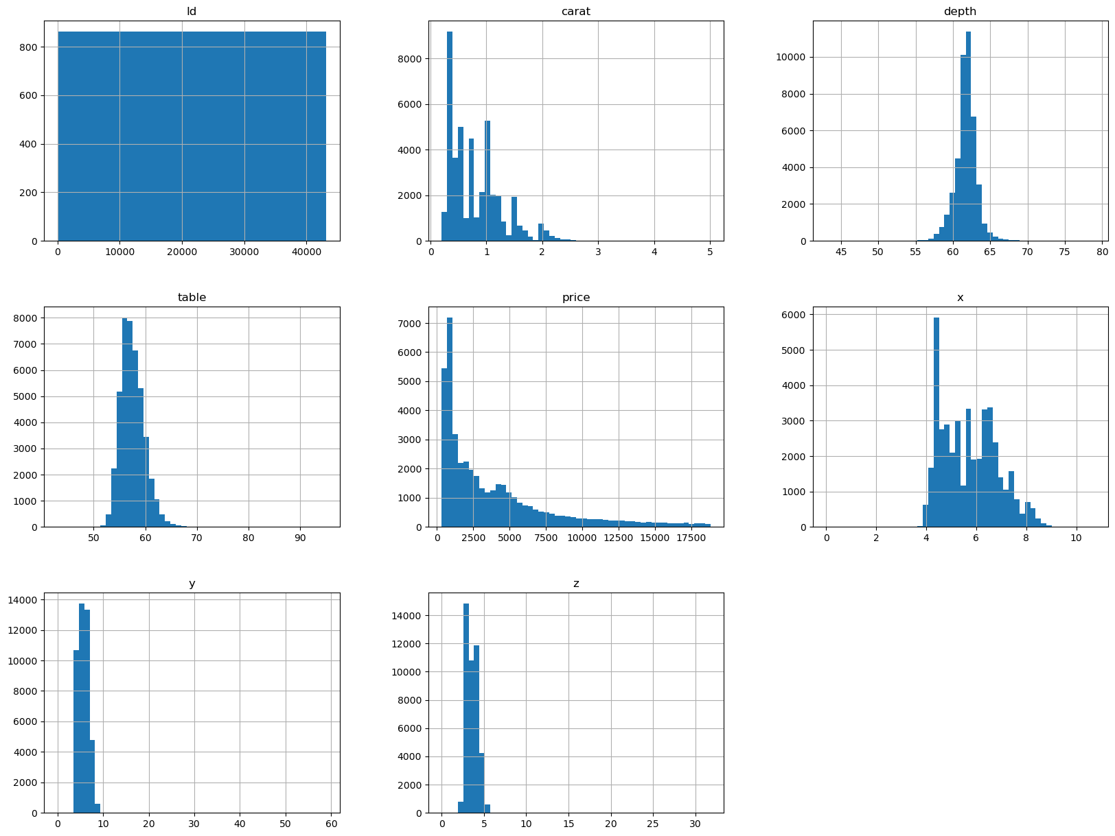
Discover and Visualize the Data
Histplot shows that the data is not normally distributed

Slide 8
Discover and Visualize the Data
# What is the relationship between diamond clarity (clarity) and price? Are higher clarity diamonds more valuable?
# We notice from the figure that the price of a diamond is clearly affected by its purity rate, as there is a variation in prices based on its purity.
#S12 is more clarity so its more price

Slide 9
Other step
# Looking for Correlations and use heat map to display it .
# Handling Text and Categorical Attributes
We use ordinary encoding not hot encoder for 2 reason
1)in hot encoder every category will become column and we have 3 categorical data 8 colmn in the clarity + 7 column in color + 4 for cut colmn =18 new colmn will added to the data The data will take up a lot of space
2) The arrangement is important. There is an advantage in the distribution in some columns, such as the cut column, as the distribution has degrees extending from ideal to fear

Slide 10
Scaling
Scaling )we use MinMaxScaler)
to scale numeric data

Slide 11
Choose and train Model
First we should split data to 2 group train data set and test data set then build and train Model .
I choose LinearRegression to train Model and Acurecy is 88 :,to To improve the model's performance use PolynomialFeatures the accuercy is 94%
To evalute the model I take random test (4 set 2 train and to test for x and y ) when I use liniear to prdict it
The accurecy is r2 score= 0.88 for train and r2 score 0.87 for test and after applied same thing on linier but use plonomial features r2 score 0.94 for train and r2 score 0.91 for test

